Slide 1

A Sweet Accident of COVID-19
-Sang Hee Kweon
-Vidyashree Ramesh
-Jing Yan
Notes:
Hello everyone, thanks for joining us today for our Data Science Hackathon Project. My name is Jing Yan, I am going to start our presentation on behave of our team with Sanghee Kwen and Vidyashree Ramesh.
We all know that Covid-19 has been a great challenge to everyone starting from 2020. While there is not doubt we all need to adjust to a new reality due to Covid-19, and it has been difficult. So instead of going for all the negatives, it would be better to look at the bright side of things.
So today we will share some good news about “a sweet accident of Covid-19”.

Slide 2
Agenda
Introduction
Research questions
Dataset overview
Data analysis
Conclusion
Future perspectives
Acknowledgment of data/ weblink resources
Notes:
During this presentation, we will share the background information about how Covid-19 pandemic is related to environmental quality. Based on the background information, we designed testable research questions. After that we will go through the data analysis that couples the Covid-19 and environmental quality at different regional scales, and show you our conclusion and future perspectives .

Slide 3
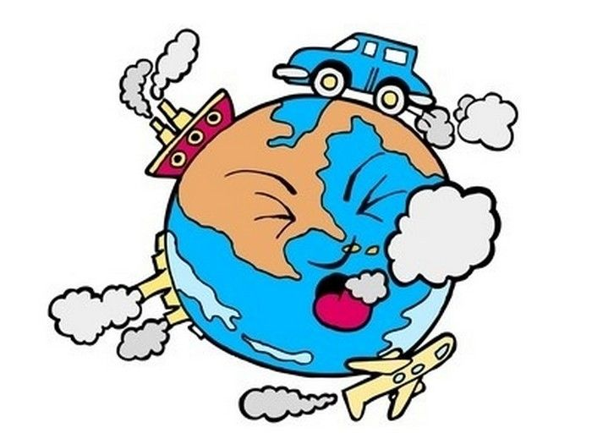
Introduction
Covid-19 virus outbreak and rate of spread/mortality skyrocket starting from early 2020.
Social distancing policies restricted people movement and largely closed business and offices, leading to less direct interactions between people and surrounding environments.
Does this relate to the changes in environmental quality?
Notes:
The Covid-19 virus has been found very infectious and social distancing has been claimed to be the best way to stop or slow down the infection.
So government started to implement social distancing all over the worlds. This practice largely change how people live their lives, for example, less travel and commute. These change the way how people affect the surrounding environments. Therefore, we wonder how does this social distancing at the different spatial scales affect the environmental quality.

Slide 4
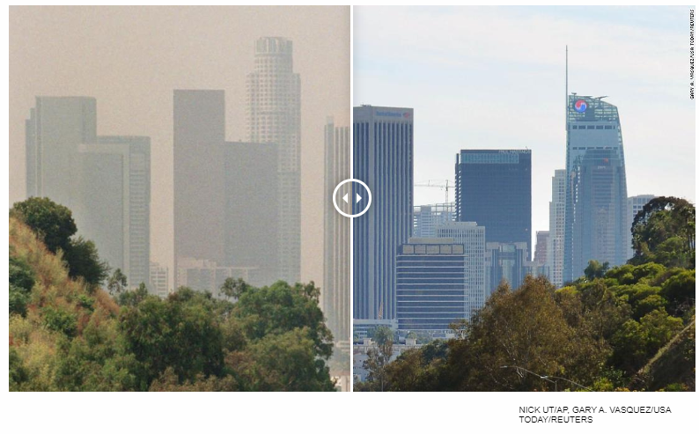
Does covid-19 pandemic affect air quality?
July 1998
March 2020
Air quality in regions of metropolitan areas, for example, Los Angeles, has been significantly improved throughout the pandemic
Social Distancing = Less Air Pollution ?
(Kann, 2020)
Notes:
The effects of social distancing on the environmental quality has been documented in recent media reports.
Here we show the picture of los angels at 1998 and 2020, demonstrating how clean the air it’s visually during the pandemic.
So this evidence make us wonder whether this happens all over the world consistently? Does social distancing equal to better air quality?

Slide 5
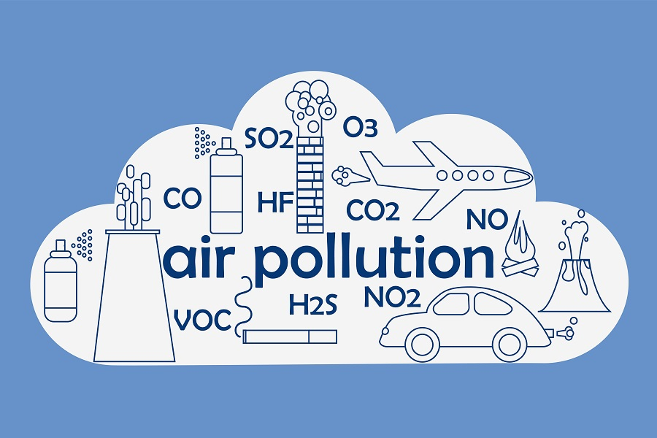
Air quality variables
Particle Pollution (particulate matter)
Ground-level ozone.
Carbon monoxide.
Sulfur oxides.
Nitrogen oxides
Lead
(Industrial Degreasers, 2018)
Notes:
When we talk about air quality, there are several key variables, including particulate matter, ozone, carbon monoxide, sulfur oxides, and nitrogen oxides, and lead. These pollutants are all too some extent related to human activities, such as travel, commute using car and plane. However, it is usually hard to identify how much of these activities affect air quality. Because, the world never stops running and we cannot do the experiments at a very large spatial scale or global scale. Therefore, the undesired social distancing allows us to test how much human activity influence the air quality at the global scale.
Nitrogen dioxide comes from vehicles, power plants, industrial emissions and off-road sources such as construction, lawn and gardening equipment. All of these sources burn fossil fuels.
https://ecolink.com/info/six-common-air-pollutants/
https://eschooltoday.com/pollution/air-pollution/common-examples-of-air-pollutants.html

Slide 6
Question
How social distancing policies affect the general air quality in regions where air pollution are prolonged issues, e.g., Los Angeles, CA?
What type of air quality, e.g., NO₂ or O₃, is the mostly impacted by social distancing?
Whether there exists a dynamic feedback between air quality and Covid-19 infections?
Notes:
Here we define three relevant questions
We will use freely available datasets collected from the government and research institutes to answer these questions.

Slide 7
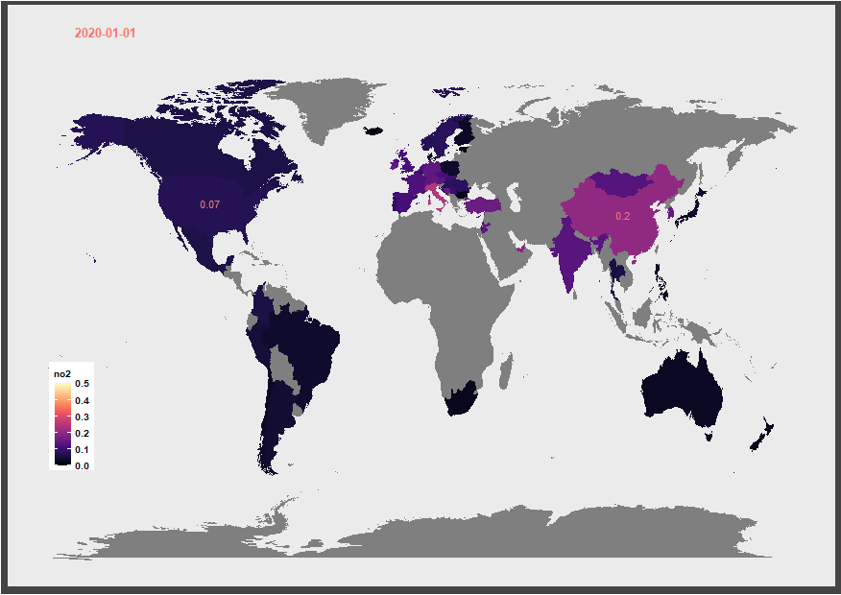
Global No₂ Map
Nitrogen oxides （NO₂）decreases during the pandemic from Jan. 1st to April 24th
NO₂ in China and USA shows different temporal patterns, given different social distancing time
Notes:
The first result we would like to show it’s the global NO2 map during Jan 1 to April 24 2020.
The NO2 level is normalized to 0 to 0.5 in the plot, the lighter the color the higher the NO2 level.
What we can see is that NO2 fluctuates a lot every day in each country. It seems there is not clear pattern to follow. However, if you follow US and China, there is a very distinct pattern in US and China.
We can look at the No2 level using a different way.
In the US, we see the NO2 drops significantly in April, while in China it increases. What happen is US started to implemented social distancing in March, while China started to loosen it in March. This suggest social distancing largely affect the air quality at certain countries.

Slide 8
Global changes of other major pollutants
Notes:
If that was not clear to you, here we show the temporal changes of different air quality variables at the global scale.
The X axis is time from Jan 1 to April 24. Y axis are the median of pollutant levels. The red line is the time a time of California started to implement social distancing, just give a sense of when people start to have less activities.
There are several variables I would like to highlight, including Carbon Monoxides, Nitrogen Oxides, and PM25. You can see these variables all consistently drops during this pandemic.

Slide 9
Relationship between Covid-19 and no₂
Does this happen at local or regional scales?
At the global scale, Cobiv-19 pandemic seems to decrease the NO₂ pollution
Notes:
Now let’s put the air quality and Covid-19 infection together. We see NO2 drops as the Covid-19 increase at the global scale. The pattern is very clear, showing there is close relationship between social distancing and air quality.
Now we will ask my teammate Vidya to share you how does social distancing affects air quality at the local or regional scales.

Slide 10

COVID-19 cases in LA improved air quality
Los Angeles county
Increase in COVID-19 cases
lockdown start on
Mar 4th
Data collected from Los Angeles county area (19thJan-19th Apr)
Imposed social distancing and stay at home on May 4th
Decrease in air pollutants

Slide 11
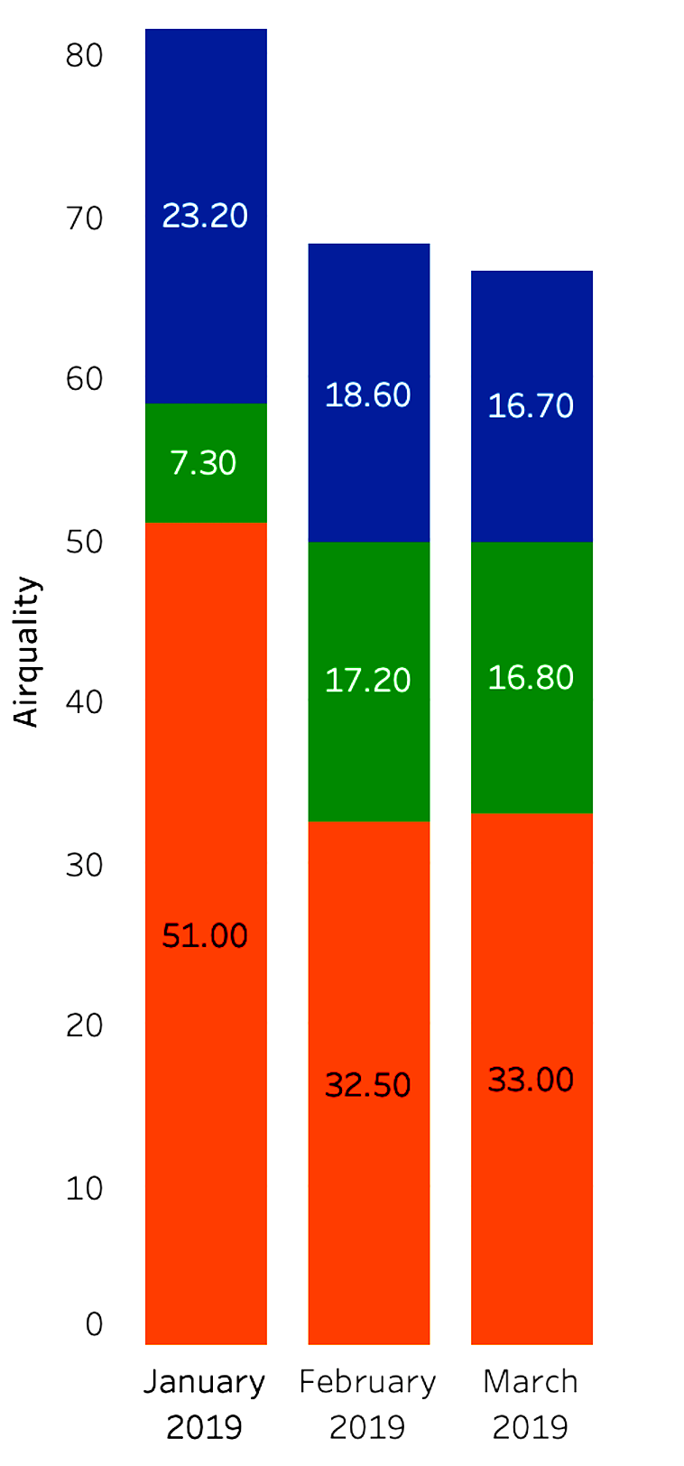
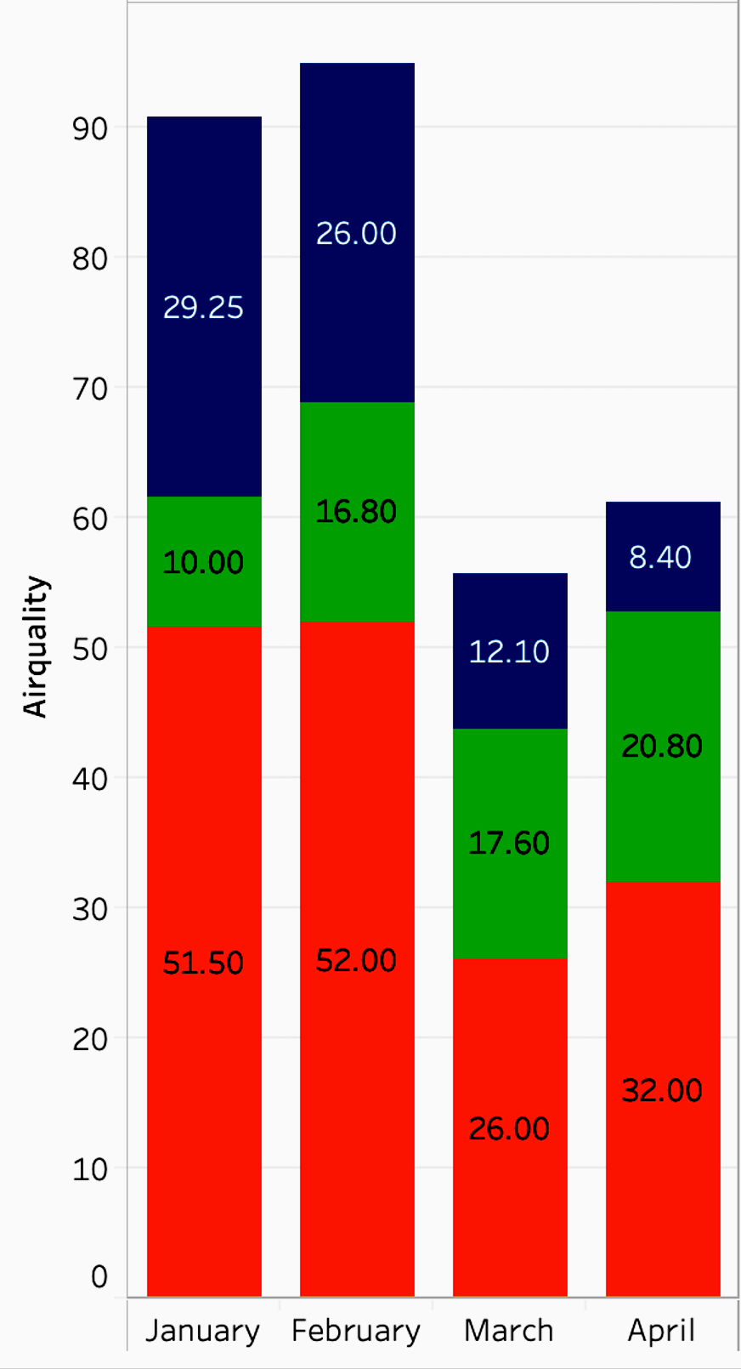
air quality better than previous year
Los Angeles county
COVID-19
First quarter 2019 and 2020 data from LA county analyzed.
Clear and drastic reduction of air pollutants observed starting from March 2020.
*
*
2019
2020
Note: 2019 April data not included

Slide 12
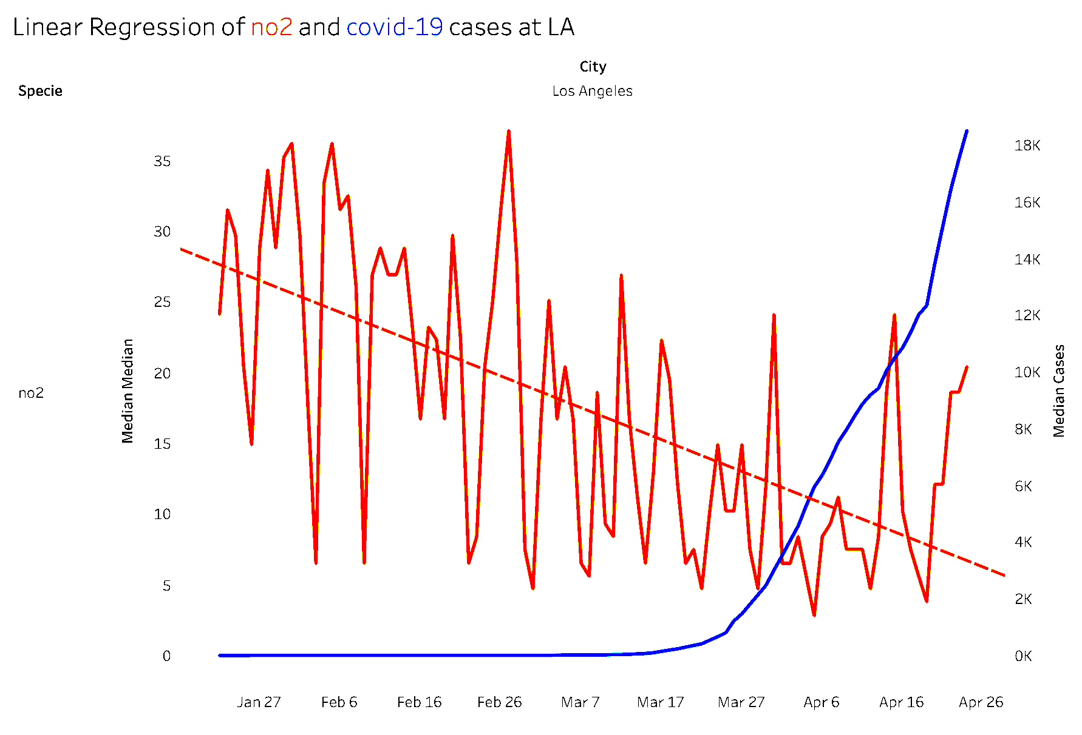
Big change in No2 pollutant
Los Angeles county
Linear regression of NO₂ and COVID-19 cases.
Clear and drastic reduction of NO₂ observed starting from March 2020.
NO₂ pollutant
COVID-19 cases
lockdown start on
Mar 4th

Slide 13
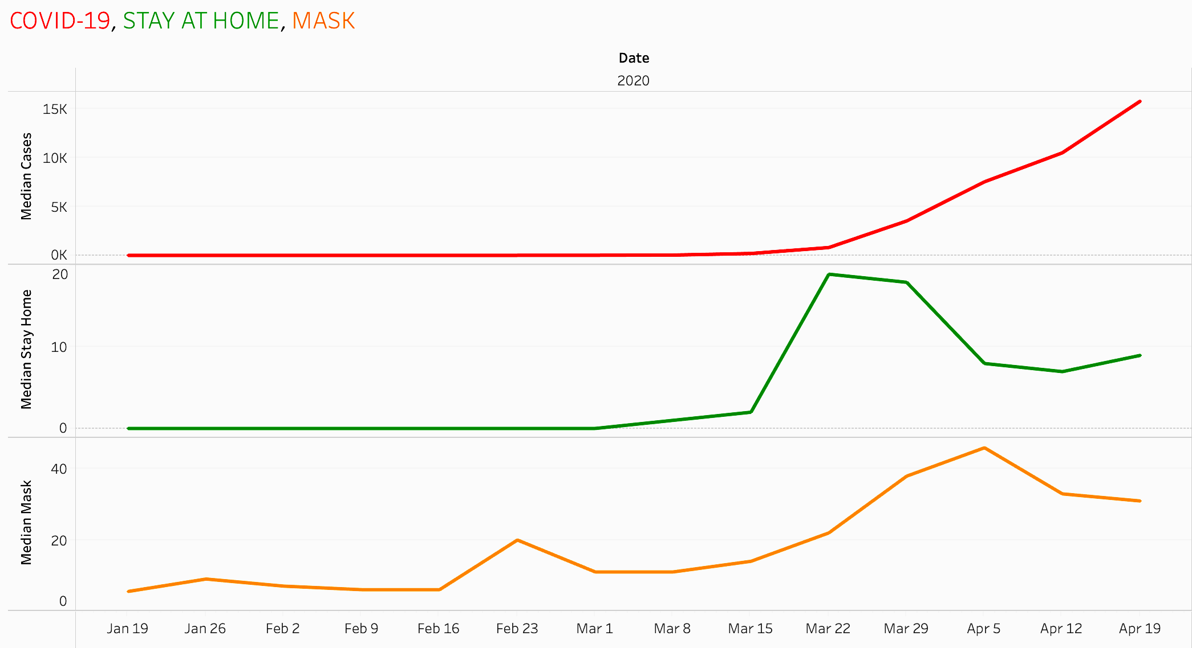
stay at home and mask use
Los Angeles county
COVID-19
We took few weeks to follow stay at home order (Mid Mar)
However, took precautions of increase mask use before disease out break (mid Feb)
Stay at Home
Mask
lockdown start on
Mar 4th

Slide 14
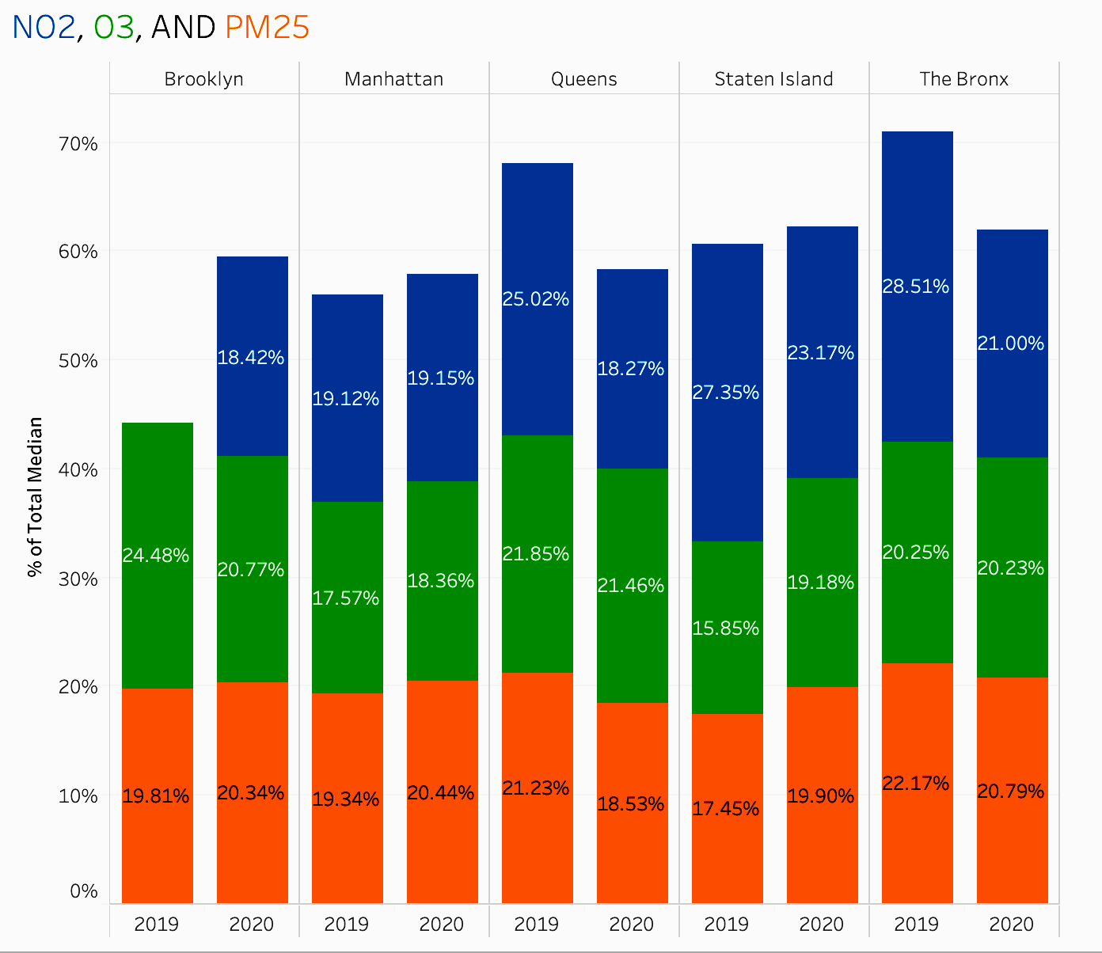
Air quality in new York city
New York City
Observed weird correlation in different parts of NYC
Queens and the Bronx improved air quality and others decreased.
*
*
Notes:
COVID-19 and Airquality of Queens

Slide 15
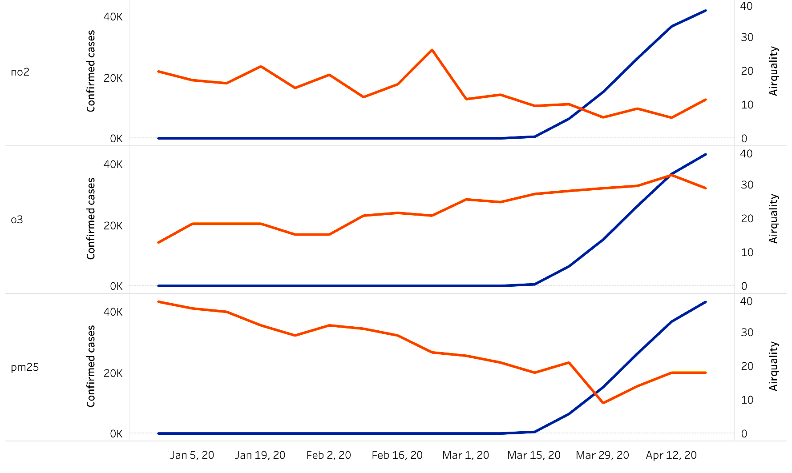
Disease and air quality in queens, NY
Queens, New York
COVID-19 cases
NO₂
Detailed analysis of Queens showed deceased in NO₂ and PM25 pollutants
COVID-19 cases
O₃
COVID-19 cases
PM25
lockdown start on
Mar 12th
Notes:
COVID-19 and Airquality of Queens

Slide 16
Conclusion and Future Perspectives
Covid-19 induced social distancing largely mitigate air pollution across regional and global scales
Levels of NO₂, PM₂₅, CO and O3 are affected due to the social distancing, although variability could occur depending on the study location
Clearly air quality negatively correlate with Covid-19 infections, but it’s difficult to predict how effective social distancing is
In summary, a new life style, e.g. less car, could help alleviate environmental issues, like air quality

Slide 17
Data Sources and References
Air Quality Open Data Platform (2020, April 24). Retrieved from https://aqicn.org/data-platform/covid19/
Covid-19 Pandemic Humanitarian Data Exchange (2020, April 24). Retrieved from https://data.humdata.org/event/covid-19/
Google Trends. (2020, April 27). Retrieved from https://trends.google.com/trends/?geo=US
Freedman, A., & Tierney, L. (2020, April 9). The silver lining to coronavirus lockdowns: Air quality is improving. Retrieved April 27, 2020, from https://www.washingtonpost.com/weather/2020/04/09/air-quality-improving-coronavirus/
Kann, D. (2020, April 7). Los Angeles has notoriously polluted air. But right now it has some of the cleanest of any major city. Retrieved April 27, 2020, from https://www.cnn.com/2020/04/07/us/los-angeles-pollution-clean-air-coronavirus-trnd/index.html

